Slide 1
Adrenal insufficiency
and adrenal crisis
Training for school employees who volunteer to help students with adrenal insufficiency

Slide 2
Allows certain school employees to volunteer and administer certain adrenal insufficiency medication at a public school.
Requires the Utah Department of Health and Human Services to create training for trained school employee volunteers
Provides liability protection for volunteers when certain adrenal insufficiency medication is administered.
Utah Code 53G-9-507 (July 1, 2024)

Slide 3
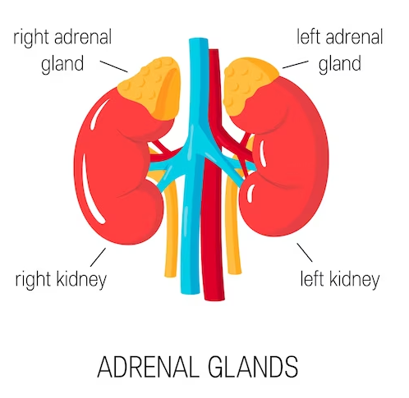
Adrenal insufficiency is a disorder that occurs when the adrenal glands do not make enough of certain hormones like hydrocortisone. The adrenal glands are located just above the kidneys.
Hydrocortisone helps maintain blood pressure and blood sugar when a person is sick or injured.
People with adrenal insufficiency need to be given hydrocortisone if they are sick or injured to prevent a life-threatening emergency called adrenal crisis.
Adrenal insufficiency

Slide 4
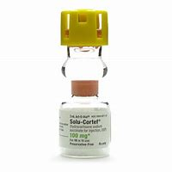
A daily maintenance dose of the oral steroid hydrocortisone. Usually taken at home.
An additional “stress dose” of oral hydrocortisone for minor illness or injury.
An injection dose of hydrocortisone for adrenal crisis (serious illness, injury, or worsening of minor symptoms).
Treatment for adrenal insufficiency and adrenal crisis

Slide 5
Identify a student with an adrenal crisis rescue authorization.
Read and follow the student’s emergency action plan.
Identify the medication prescribed for the student.
Recognize the signs when oral medication is needed for a “stress dose.”
Recognize the signs when injected medication is needed for an “adrenal crisis.”
Administer the medication as prescribed.
Notify the student's parent when the child is sick or injured.
Call 911 and the student’s parent if they are seriously ill, injured, or receive an emergency injection of hydrocortisone
Trained school employee volunteer must

Slide 6
Signs indicating the need for an oral “stress dose” of medication
Common signs include:
Fever
Vomiting (one time)
Serious injury (broken bones, head injury, auto or bike accident)

Slide 7
Adrenal insufficiency “stress dose”
If you see this:
Do this:
Fever
Vomiting (one time)
Serious injury (broken bones, head injury, auto or bike accident)
Call parents/guardian.
Give oral medication as prescribed
Offer small sips of water, sports drink, or clear carbonated beverage until parents arrive if the medication was given due to vomiting.
Watch for continued or worsening symptoms
Complete required documentation.

Slide 8
Adrenal crisis
Adrenal crisis means a sudden, severe worsening of symptoms associated with adrenal insufficiency, including
Vomiting
Diarrhea
Dehydration
Low blood pressure
Loss of consciousness
Severe pain in the lower back, abdomen or legs.
A student in an adrenal crisis must receive injected hydrocortisone (not oral) and see a physician immediately!

Slide 9
Common signs include:
Unconscious
Vomiting more than once
Diarrhea, dehydration, low blood pressure
Severe pain in the lower back, abdomen, or legs
Altered mental status (excessively weak or tired, disoriented, confused, or slurred speech)
Signs indicating adrenal crisis (student needs an emergency injection dose of hydrocortisone)

Slide 10
Adrenal crisis: injectable dose
If you see this:
Do this:
Unconscious
Vomiting more than once
Diarrhea, dehydration, or low blood pressure
Severe pain in the lower back, abdomen, or legs
Altered mental status (excessively weak or tired, disoriented, confused, or slurred speech)
Call 911 and notify the parent.
Locate medication.
Have student lie down and turn on their side.
Inject medication intramuscularly into thigh muscle (trained staff only).
Stay with the student and monitor their breathing and consciousness.
Give emergency instruction from healthcare provider to paramedics.
Complete required documentation.

Slide 11
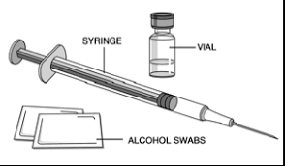
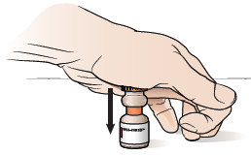
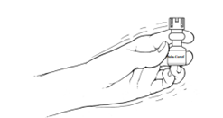
Instructions for administering adrenal crisis injection
Gather emergency adrenal crisis injection kit containing prescribed medication, syringe, and alcohol wipes.
Wash your hands and put on gloves. Read the label and check the expiration date.
Press firmly down on the yellow top to force the rubber stopper into the vial releasing the solution.
Gently mix the solution by turning the vial upside down several times (do not shake).

Slide 12
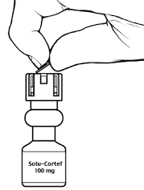
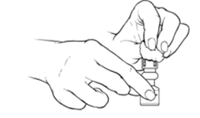
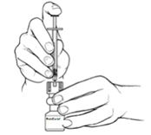
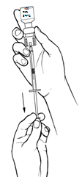
5. Remove the plastic tab covering the rubber stopper.
6. Clean the rubber top with an alcohol wipe.
7. Place the vial on a firm surface and insert the needle into the rubber stopper.
8. With the syringe in the vial, turn the bottle upside down and pull back on the plunger of the syringe to withdraw the correct dose.

Slide 13
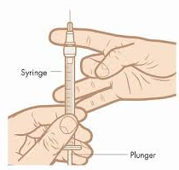
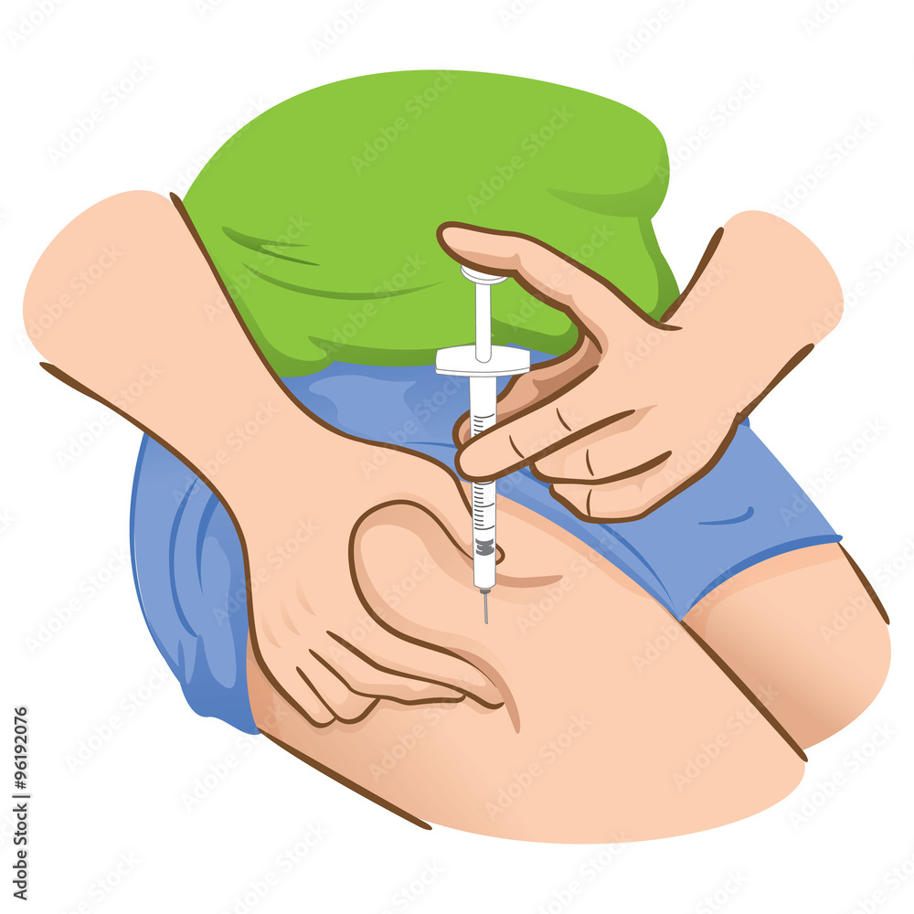
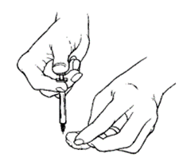
9. Flick out any air bubbles and expel any excess air. Remove syringe from vial.
10. Select the site. Injection should go into the outside of the mid-thigh. Clean the skin surface with an alcohol wipe. Inject needle into leg muscle at a 90-degree angle into bare skin. Push the plunger until the dose is fully injected.
11. Remove needle and place in sharps container. Press a cotton ball firmly over the site for a few seconds.
12. If the student is unconscious, place them on their side. Stay with the student and continue to observe. The injection will work quickly.

Slide 14
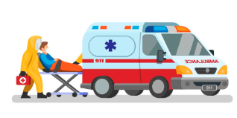
Tell emergency personnel what actions you took and give them the used medication vial and emergency instruction, if provided by parents.
Complete documentation
When help arrives

Slide 15
Thank you for viewing this training and volunteering to help students who have adrenal insufficiency.

