Slide 1
Seizure rescue medication: training unlicensed assistive personnel to administer seizure first aid, interventions, and rescue medication in the school setting
as outlined in UCA 53G-9-505

Slide 2
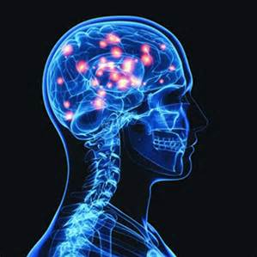
Seizure: uncontrolled electrical disturbance in the brain.
Most seizures stop without intervention and do not cause injury.
Some seizures do not stop without intervention and can lead to brain damage.

Slide 3
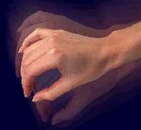
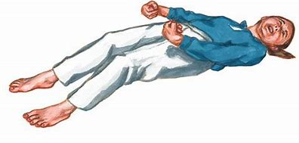
Different types of seizures
Some seizures manifest as blank stares
or daydreaming.
Some involve repeated movements
or movement that affects only one side of the body.
Other seizures such as generalized (grand mal, tonic-clonic) cause
Full body with stiffening, twitching, loss of consciousness

Slide 4
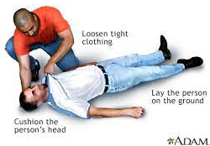
First aid for all seizures
Stay calm
Note time seizure starts
Protect person from injury by moving or cushioning objects nearby
Lower person to the floor
Place something soft under the head
Turn person onto side
Do not hold person down
Do not put anything in the mouth
Notify parent

Slide 5
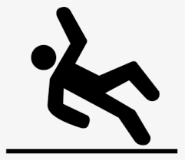
Seizures are a medical emergency if the person:
Has epilepsy and seizure doesn’t stop after an extended amount of time (5 minutes).
Has NO KNOWN history of seizures.
Is injured, ill or hit in the head and has a seizure.
Has diabetes.
Is pregnant.
Is in the water.
For any of these situations Call 911

Slide 6
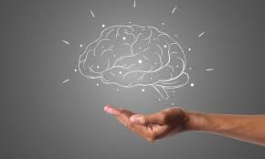
One or more of the following interventions or medications has been prescribed for a student in your care.
Neurostimulation
Vagus Nerve Stimulator (VNS)
Responsive Neurostimulation (RNS)
Deep Brain Stimulation (DBS)
Seizure rescue medication
Buccal Route
Nasal Route
2 syringe-atomizer
Prefilled spray device
Rectal Route
Follow the healthcare plan to find out which intervention has been prescribed for your student.

Slide 7
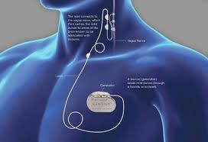
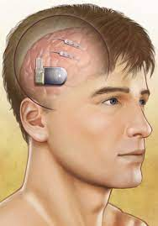
Neurostimulation
Vagus Nerve Stimulator (VNS)-Some people with epilepsy have a small device implanted in their upper chest. The device sends electrical signals to the brain that can help control seizure activity. Trained personnel can use the provided magnet to slowly pass over the area (over the clothing) where the VNS is implanted. Can be used before and during a seizure as indicated in the healthcare plan. Intervention required. Responsive Neurostimulation (RNS) -Implanted in the skull to detect and stimulate abnormal electrical activity in the brain. No intervention required.
Deep Brain Stimulation (DBS)- A small neurostimulator is surgically placed under the skin in the chest or abdomen to deliver controlled electrical stimulation directly to specific areas in the brain. No intervention required.

Slide 8
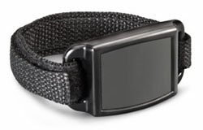
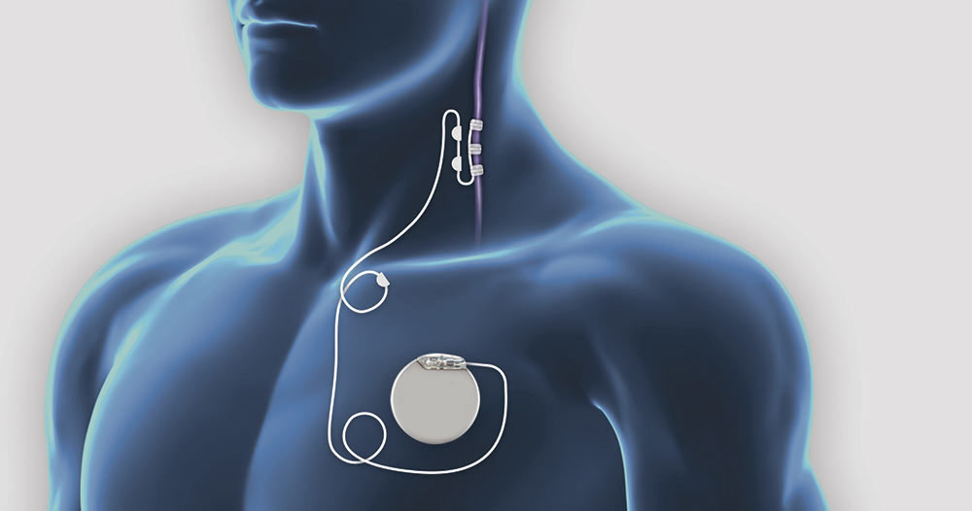
Swipe magnet across left side of chest, over VNS battery, counting “one-one thousand, two-one thousand”.
Wait one minute and repeat as needed for seizure activity.
Vagus Nerve Stimulation (VNS)

Slide 9
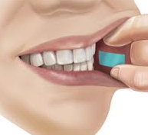
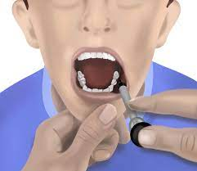
Comes as a liquid (in oral syringe) or tablet form.
2. If excessive saliva, dry area between cheek and gums using a tissue.
3. Place the tablet or squirt liquid medication between cheek and outer gum line.
4. Gently rub the outside of the cheek where the medication was placed.
Buccal administration (e.g. lorazepam)

Slide 10
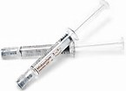
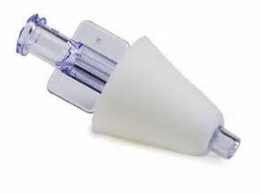
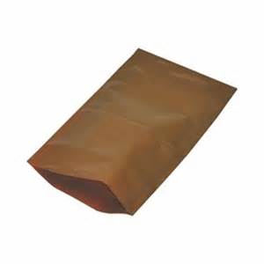
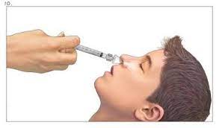
2 (two) prefilled (by pharmacist) syringes along with an atomizer in light sensitive bag.
Twist atomizer onto one syringe, place soft tip in one nostril.
Swiftly push plunger to empty entire contents into nostril.
Switch atomizer to other syringe and repeat process in other nostril.
Should be stored in light sensitive bag.
Intranasal administration: syringe and atomizer (e.g. Versed/midazolam)

Slide 11
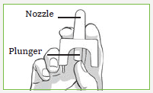
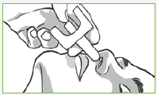
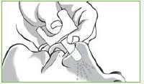
Manufactured nasal sprayer:
Open box, remove one package.
Peel paper off blister pack.
Use one device by positioning thumb on plunger and first and middle finger on either side of nozzle.
Insert nozzle into one nostril, depress plunger.
Use second nasal spray IF ORDERED BY MEDICAL PROVIDER.
Intranasal administration: manufactured nasal sprayer (e.g. Valtoco/Nayzilam)

Slide 12
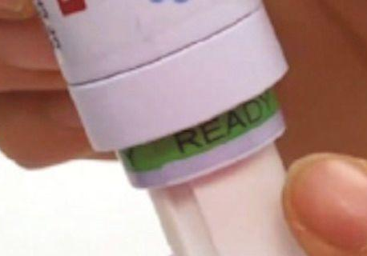
Delivered in a prefilled syringe with dosage dialed and locked by the pharmacist, indicated by ready green band.
Remove cap of syringe, apply lubricant jelly to tip of syringe.
Insert entire tip of syringe into students’ rectum. Slowly push plunger to give prescribed dose. Hold syringe in place for 3 seconds to keep medication from oozing back out.
Rectal medication (e.g. Diastat/diazepam)

Slide 13
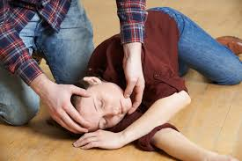
After administration of any seizure rescue medication and while waiting for EMS:
Assure student is lying on their side (recovery position) with something soft under their head.
Monitor student’s seizure activity.
Monitor student’s breathing.

Slide 14
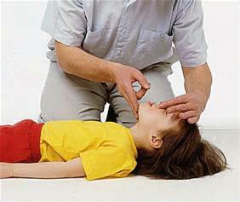
If breathing does not resume after seizure:
Call for AED (Automatic External Defibrillator).
Have trained staff perform CPR.
If necessary, place AED and follow AED prompts.

Slide 15
Thank You for Viewing Seizure Rescue Medication Training.

