Slide 1
Children with diabetes
Glucagon training for school staff
Notes:
Introduce yourself.
Ask how many of your audience has known someone with
diabetes.
What they know might be associated with is adults with
diabetes (Type 2) or not the most current information.

Slide 2
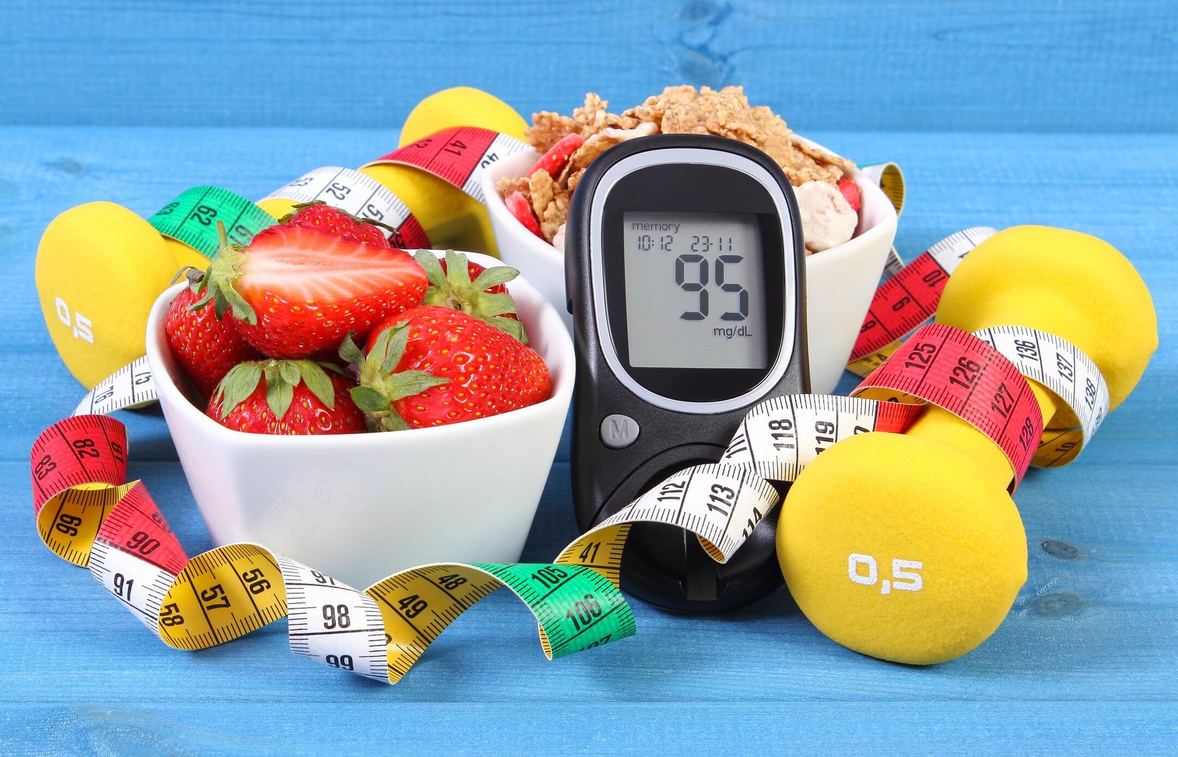
Understand what diabetes is.
Recognize a hypoglycemic reaction.
Understand the intended purpose and the side effects of glucagon.
Be able to administer glucagon if needed.
Goals for today

Slide 3
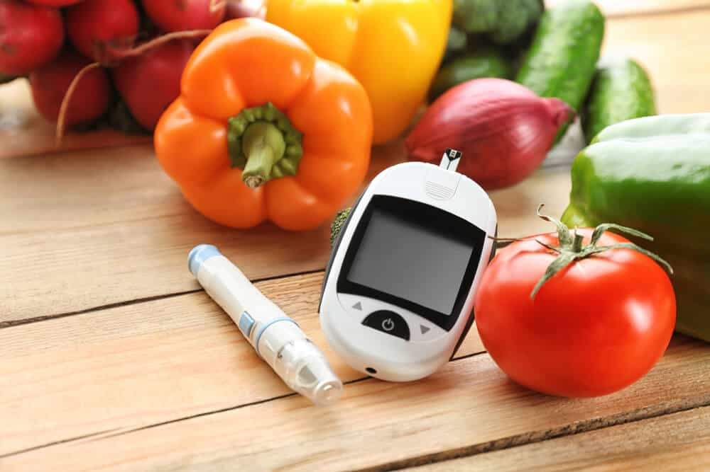
Diabetes is a condition in which the body cannot use, or does not produce enough insulin.
Without insulin, the body cannot get the blood glucose into the cells for energy.
What is diabetes?
Notes:
Diabetes is one of the most common chronic diseases of childhood.
It is not preventable, not predictable.
The incidence is increasing worldwide.
Etiology is thought to include a genetic predisposition and a triggering event such as a viral infection or a antigenic stimulus.
This diagnosis affects not just the person… but their entire family and the school as well!

Slide 4
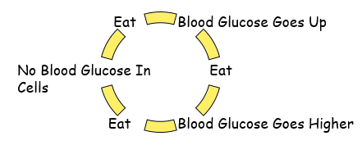
High levels of blood glucose build up in the blood.
The blood glucose cannot get into the cell to provide energy.
Without insulin…

Slide 5
This is called hyperglycemia
Notes:
This condition is called Hyperglycemia (blood glucose over 300 - see student emergency action plan for student specific number.)
Hyperglycemia is a common problem with diabetes.
Hyperglycemia is how a person usually presents when they are first diagnosed with diabetes.
At the time of diagnosis they can be quite ill.
They are usually in the hospital until an insulin treatment plan is established.
Once they are stabilized, hyperglycemia becomes an issue for testing blood and one that requires insulin, but it is not the life threatening emergency that a low blood sugar creates.

Slide 6
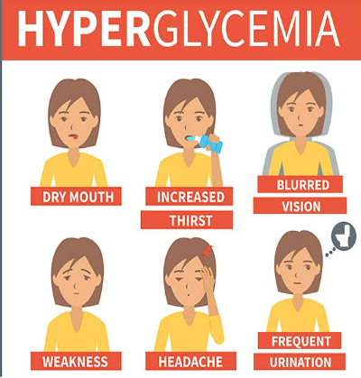
Hyperglycemia signs and symptoms:
Frequent urination
Increased thirst
Increased hunger
Fatigue/weakness
Weight loss
Blurry vision
Fast, deep breathing
Slow or confused thinking
Hyperglycemia causes:
Too much food
Not enough insulin
Decreased activity
Illness or stress
Hyperglycemia: Signs and Symptoms
Notes:
This is the student who is frequently requesting to go to the bathroom.
They are frequently complaining of being hungry and thirsty.
The student is often tired and appears not to be paying attention.
Grades may fall or test scores go down during this time.

Slide 7
Mild/moderate hyperglycemia treatment
Allow liberal bathroom privileges
Encourage student to drink water or sugar-free drinks
Check blood glucose
Contact parent if over 300 (or whatever the student-specific number is)
Severe hyperglycemia treatment
If student vomits or is lethargic – call parent/guardian.
If parent/guardian is unavailable, call 911.
Hyperglycemia: Treatment
Notes:
The treatment is aimed at maintaining the levels of sugar in the blood stream. It consists of insulin injections, understanding dietary requirements, and planning the amount of exercise for that time. It requires frequent blood sugar checks on a daily basis.
Insulin dose is calculated from the blood sugar with the food to be eaten. The amount of exercise is also a consideration.
The importance of maintaining good control is not only that the person feels better and can perform better in school, but we now know that good control will reduce the risk of long term complications and make for a healthier adult.
Good control must be a balance with a risk for hypoglycemia and participation in all childhood activities.

Slide 8
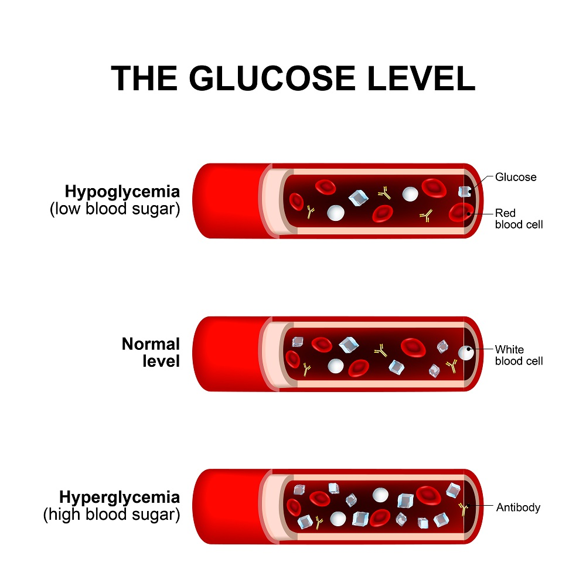
Not typically an emergency
Since symptoms for hyper/hypo can be similar – always good to verify with finger stick
Allow free access to water and bathroom
Exercise will bring it down
Parent/guardian can treat most highs when the students gets home from school.
Hyperglycemia (continued)
Notes:
Hyperglycemia, however is not a school emergency and does not require leaving school. It comes on slowly over many hours. The student may complain of not feeling well or that they feel sick.
It is always good to check a blood sugar.
Allow free access to water and the bathroom. Exercise will also help the blood sugar(glucose) come down. Notify parents of the blood sugar (glucose) level. There can be many causes for hyperglycemia including stress, extra food, or illness.
This is a problem that is not good for their health, but can be usually be handled at home. If it is happening often the doctor will more than likely increase the dose of insulin. But again this is not a school emergency.
Exercise and insulin will bring the blood sugar down.

Slide 9
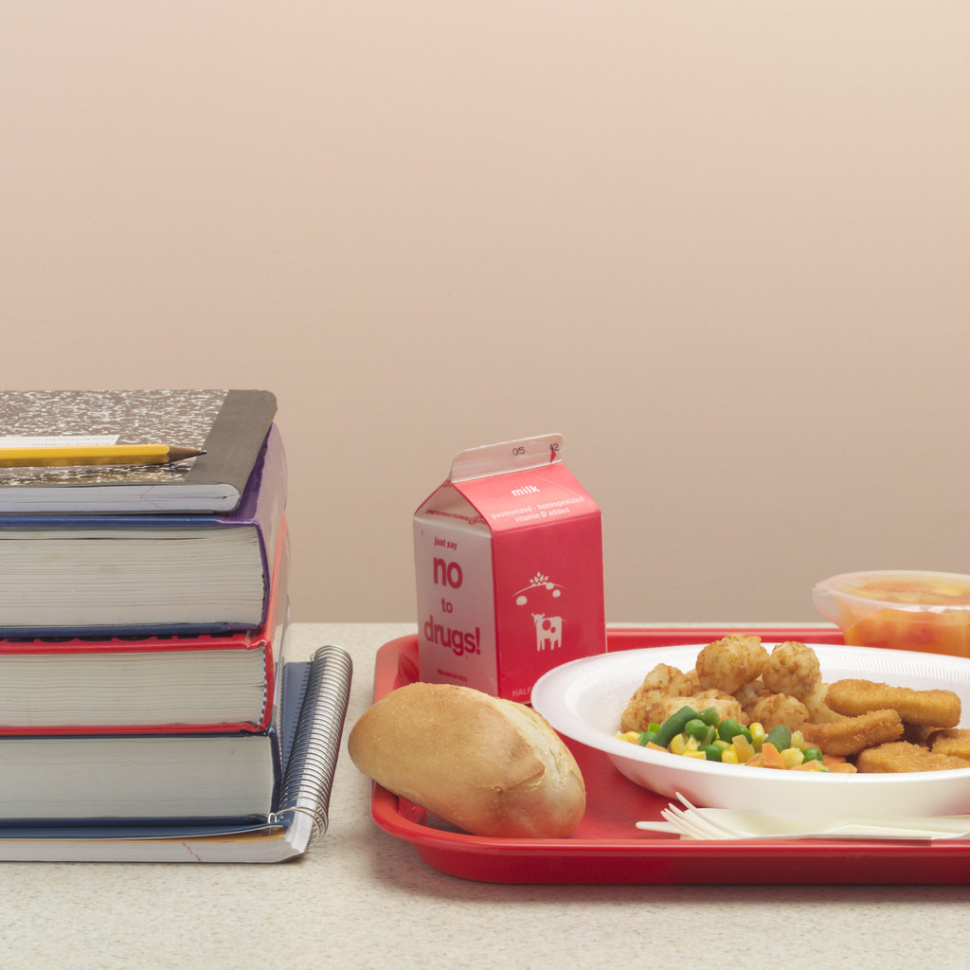

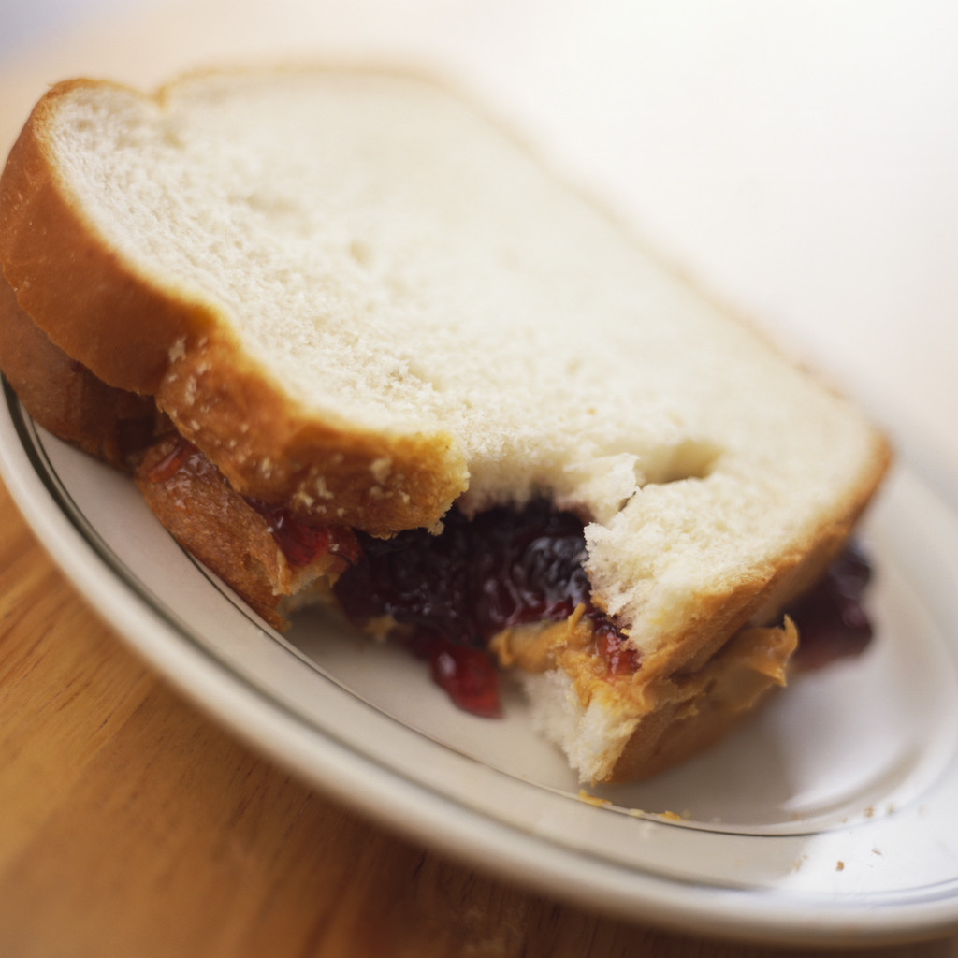
Good nutrition is important to everyone, however a student with diabetes must plan their meals carefully.
A balanced diet, with a moderation of concentrated sweets is the best.
Counting the carbohydrates in foods is called Carb Counting.
Insulin is given according to the carbs eaten.
Meal Plans
Notes:
Many people think that a person with diabetes can no longer have any sugar in their diet. What is true is that they must calculate how many carbohydrates they have eaten for the amount of insulin they have taken, or how much insulin they will need to take for what they plan to eat.
Good nutrition is important for all of us. A student with diabetes is taught a sensible and healthy way to eat. What ever they choose to eat , however, the proper amount of insulin needs to be given to keep the blood sugar (glucose) in line.

Slide 10
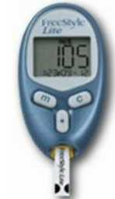
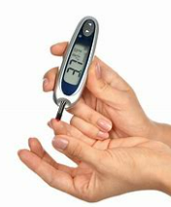
Daily blood glucose checking is an important part of diabetes control.
Blood glucose checks are usually done before meals, at bedtime, and with exercise.
When in doubt, CHECK the blood glucose if the student is not feeling well or is complaining of feeling “low”.
Blood Glucose Testing

Slide 11
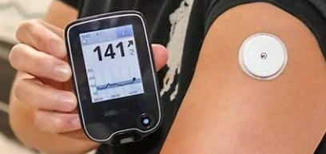
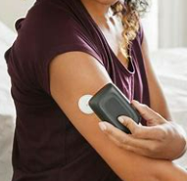
Continuous Glucose Monitoring (CGM) automatically tracks glucose levels day and night.
Reads interstitial fluid, not blood, so readings may vary from glucometer.
Can set alarms to notify for high or low blood glucose.
Some CGMs can be used to make treatment decisions, others must have number verified with glucometer.
Continuous Glucose Monitoring Systems
Notes:
Alarms should be set to not alarm unnecessarily and disrupt the class frequently, but set to ward of possible low or high blood glucose levels
Parent/guardian are responsible for changing sensor/site. This should not be done by school personnel.
Monitoring of the CGM in the school setting is not required by school personnel unless the alarm sounds indicating a possible high/low BG.
If anything needs to be done with the CGM device a parent/guardian must come to the school to manage it.

Slide 12
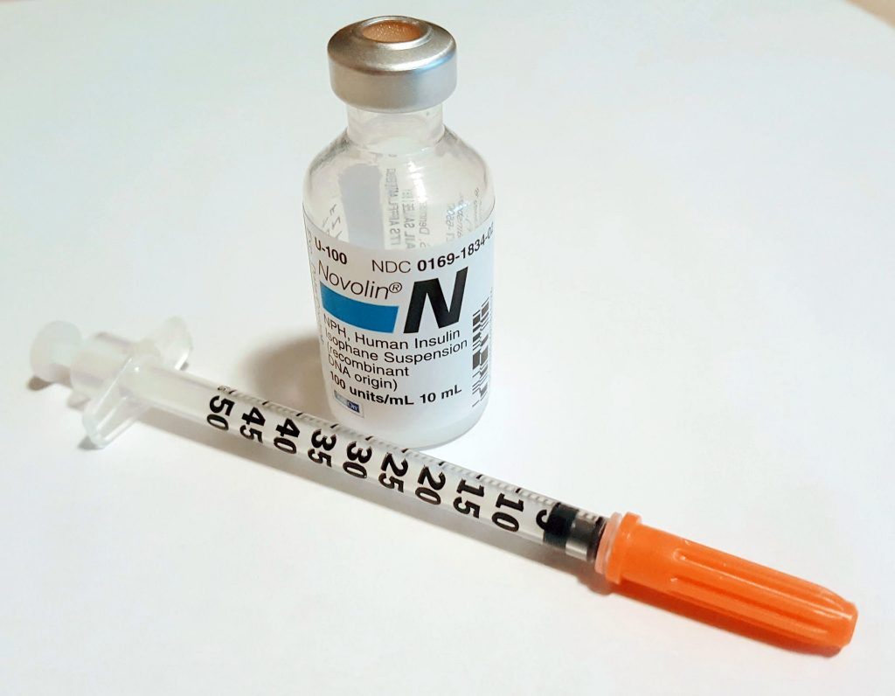
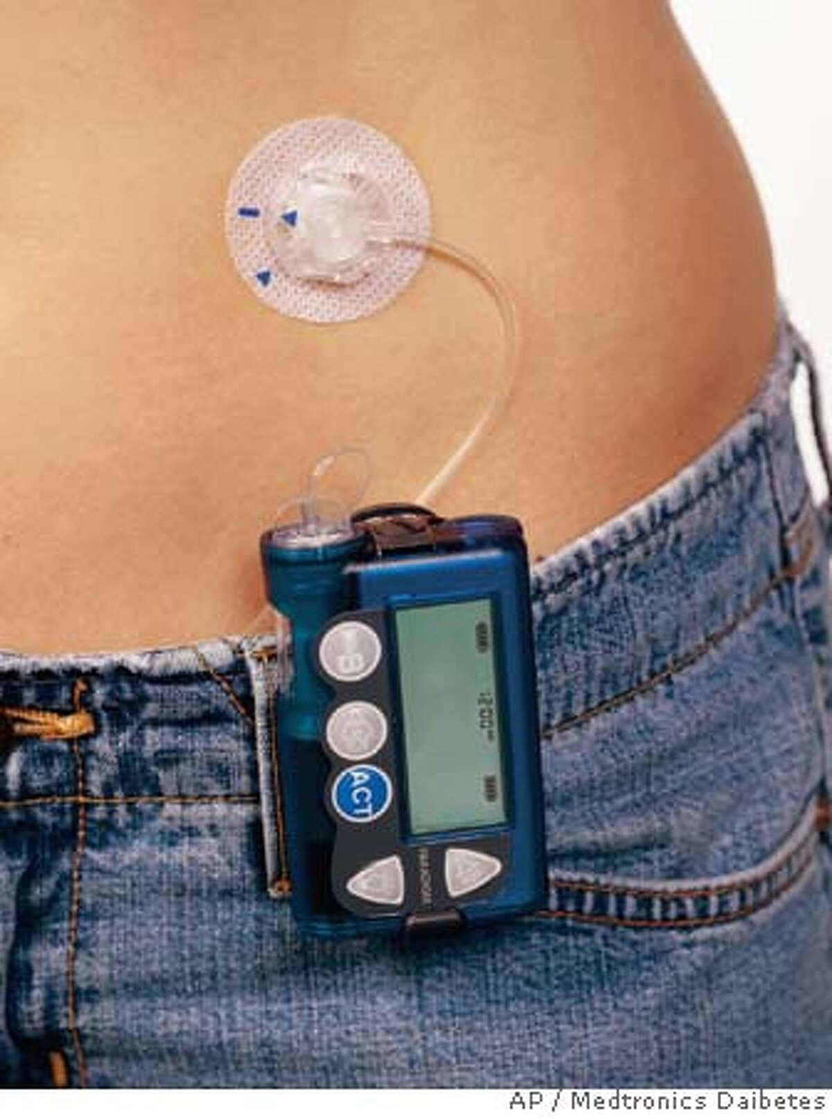
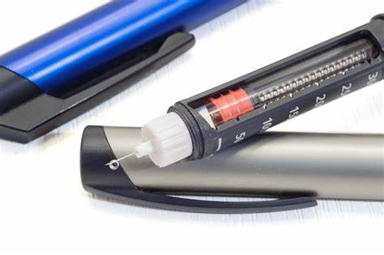
Insulin
Insulin is a hormone secreted by the pancreas. With diabetes it must be given as an injection.
The dose will vary with the blood glucose level, food intake and exercise.
Can be given via a syringe and vial, an insulin pen, or an insulin pump.
Notes:
All insulin is injected. It is given to cover carbohydrate intake and correct for “out of range” blood glucose.
There is no “routine” insulin schedule. The treatment is tailored to meet the needs and the skills of every student. It was once considered “routine” even state of the art to have 3 injections of insulin a day… now you may need 7 injections a day.
The are many new kinds of insulin and new delivery systems. Some insulins act immediately, others are short acting, while some others are long acting.
The goal is to individualize the therapy so as to minimize the intrusion into their lives.
Some students will use a pump… other a pen… and some will use a regular syringe for the injection.
Insulin must be coordinated with food.
The more frequent use of pumps and long acting insulin has increased the need for a lunch time insulin shot at school

Slide 13
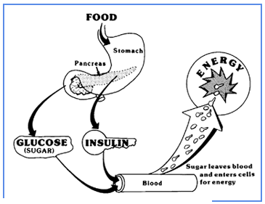
Insulin should…..
Lower the blood glucose.
Facilitate the blood glucose getting into the cells to provide energy.
Notes:
Insulin will lower the blood glucose. It is the “key” that allows the sugar to get into the cells. Remember, the sugar provides the energy to every cell very much like the gas in a car. Without fuel the motor will not run. Without the key… the insulin, our motor cannot get the fuel it needs. Without fuel the body cannot function. Again, without insulin the sugar builds up in the blood, but cannot get into the cells to provide the energy necessary.
But, too much insulin is another, more serious concern.

Slide 14
Exercise
When the student exercises, the body uses the blood glucose more effectively, which can lead to low blood glucose (hypoglycemia).
Notes:
Exercise can dramatically lower the sugar in the blood stream. It can cause the blood to get dangerously low. This is why the student with diabetes may need to check their blood glucose or eat extra food to cover the activity.
Just part of the delicate balancing act that good control of diabetes requires.

Slide 15
Insulin can cause blood glucose to fall too low when:
Too much insulin is given.
Not enough food is eaten.
Too much exercise
This is called hypoglycemia
Notes:
But, with too much insulin… a life threatening condition develops… often referred to as an insulin reaction or low blood sugar.
This is a school EMERGENCY!

Slide 16
Hypoglycemia is a medical emergency!
Hypoglycemia can be life threatening if not treated because the only energy source for the brain is blood glucose.
Notes:
This is the real balancing act I have been talking about.
Unlike hyperglycemia… HYPOGYCEMIA is a medical emergency!

Slide 17
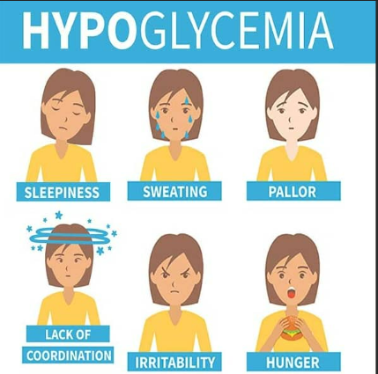
Mild hypoglycemia symptoms
Hunger
Sleepiness
Dizziness
Emotional
Irritability
Moderate hypoglycemia symptoms
Blurry vision
Weakness
Confusion
Poor coordination
Severe hypoglycemia symptoms
Combative
Seizure
Loss of consciousness
Death
Symptoms for hypoglycemia
Notes:
NEVER ignore a low blood glucose. This can lead to death if not treated!
Symptoms can vary. Some children have unique symptoms, but in general these are the most common symptom.
When in doubt, treat as a HYPOGLYCEMIC reaction, but it is always helpful to get a blood sugar reading.

Slide 18
Mild/moderate hypoglycemia treatment
Give fast acting sugar source (typically 15 grams of carbohydrates), then wait 15 minutes and check again.
Repeat if necessary.
Follow with a protein snack.
Severe hypoglycemia treatment
Don’t give anything by mouth.
Position on side if possible.
Administer glucagon (if ordered).
Call 911
Call parent/guardian
Stay with student
Actions for hypoglycemia
Notes:
No one can prevent all lows, but recurrent episodes may be preventable.
Recurrent mild episodes may be evident as poor school performance.
Most commonly happens after gym and before lunch.
Never send a student out of the classroom alone if you suspect a hypoglycemia reaction or they are not feeling well.
This is the one time that a diabetic absolutely needs to have sugar! Without sugar the cells in the body will die!
No one can prevent all lows, but recurrent episodes may be preventable.

Slide 19
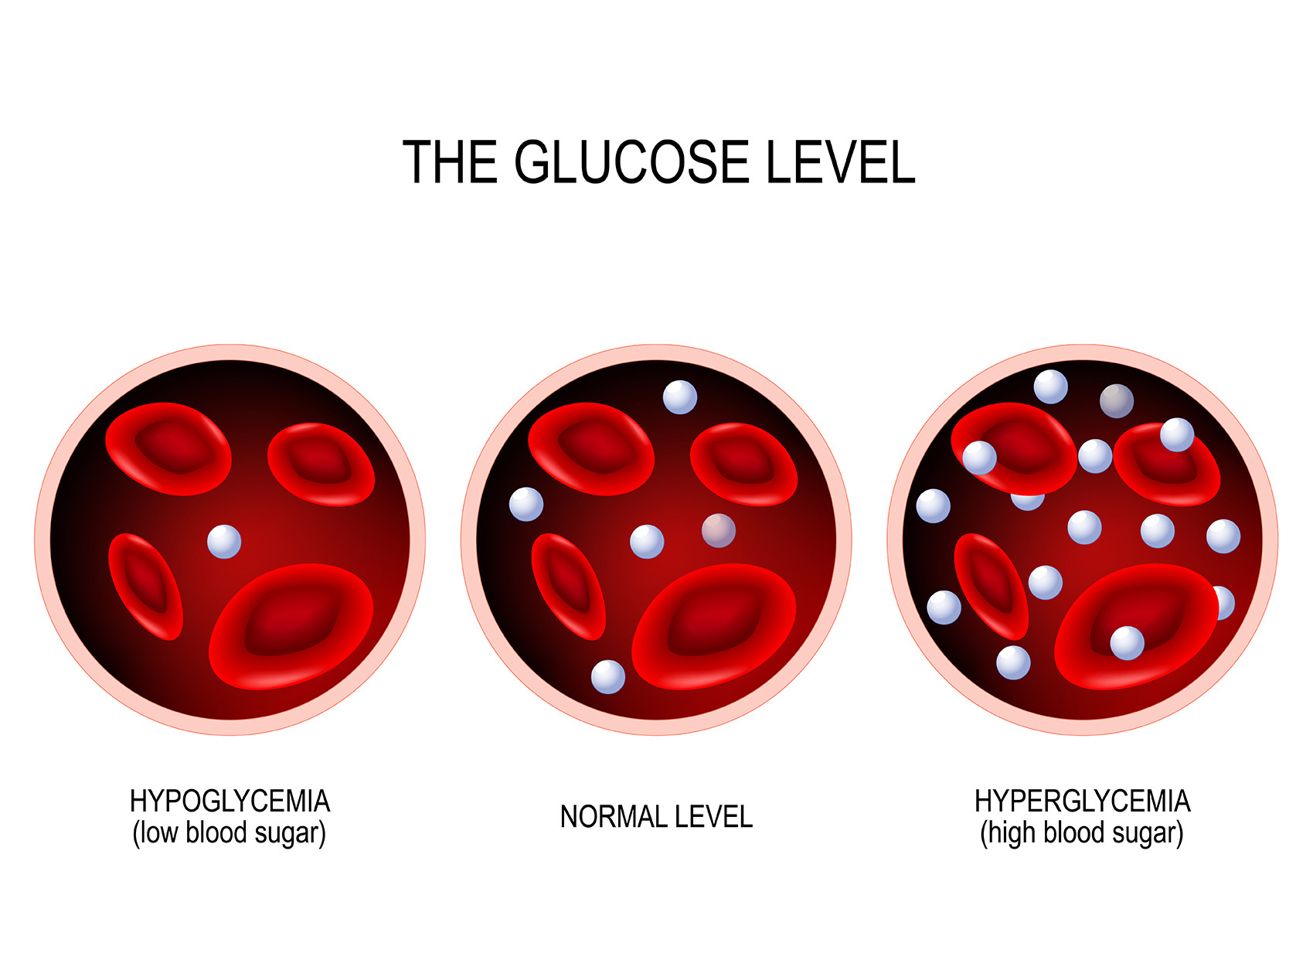
When in doubt or unable to check the blood glucose, treat as a hypoglycemic reaction (more life-threatening).
Remember the 15-15 rule: give 15 grams of carbohydrates, wait 15 minutes, then recheck the blood glucose. Repeat if needed.
Fast acting sources of sugar
            a. 6 oz of regular soda (not diet) or fruit juice
            b. 3-4 glucose tablets
            c. glucose gel
Hypoglycemia or Hyperglycemia?
Notes:
The important thing to remember is that if you are in any doubt if this could be hypo or hyperglycemia you should treat as if it were hypoglycemia! It is safer to treat with sugar than to wait for the blood sugar to drop lower and the symptoms progress.
You should not over treat… but treating a low blood sugar is the most important thing to remember!.

Slide 20
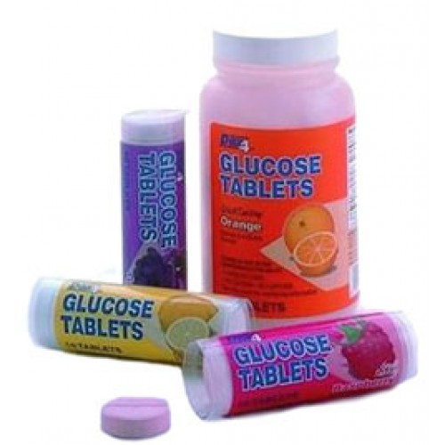
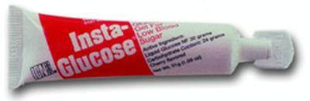
Glucose gels and/or tablets can be used to treat hypoglycemia
Examples: Insta-glucose, Glucose 15, Glucose tablets, Dextrose tablets
Gels are placed in the student’s mouth toward the cheek and back teeth.
Hypoglycemia with decreased awareness
Notes:
As the blood sugar continues to drop the symptoms become more and more obvious.
A decrease is the level of awareness is an indication of a very low sugar and must be addressed quickly.

Slide 21
Treatment for an unconscious student

Slide 22
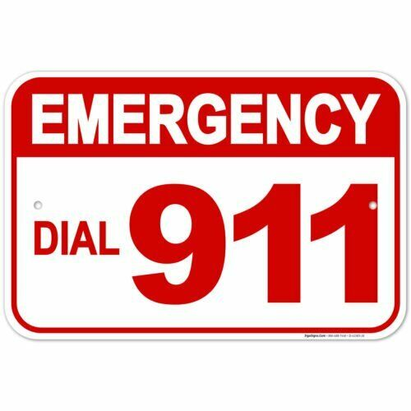
Identify someone to call 911
Turn him/her on their side
Give Glucagon
Call the parent
Treatment for an unconscious student
Notes:
Glucagon should be given when the hypoglycemia is severe enough that the individual cannot swallow safely.
Once the blood sugar has gotten this low it is imperative that emergency medical helped is called.
Follow the direction of the emergence medical team.

Slide 23
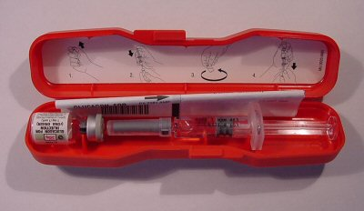
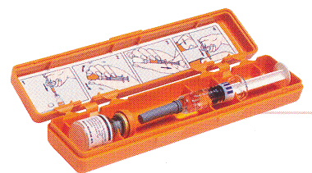
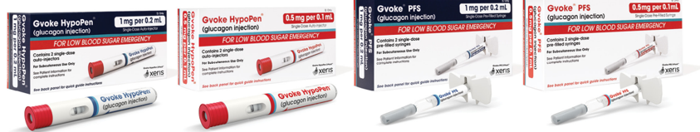
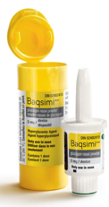
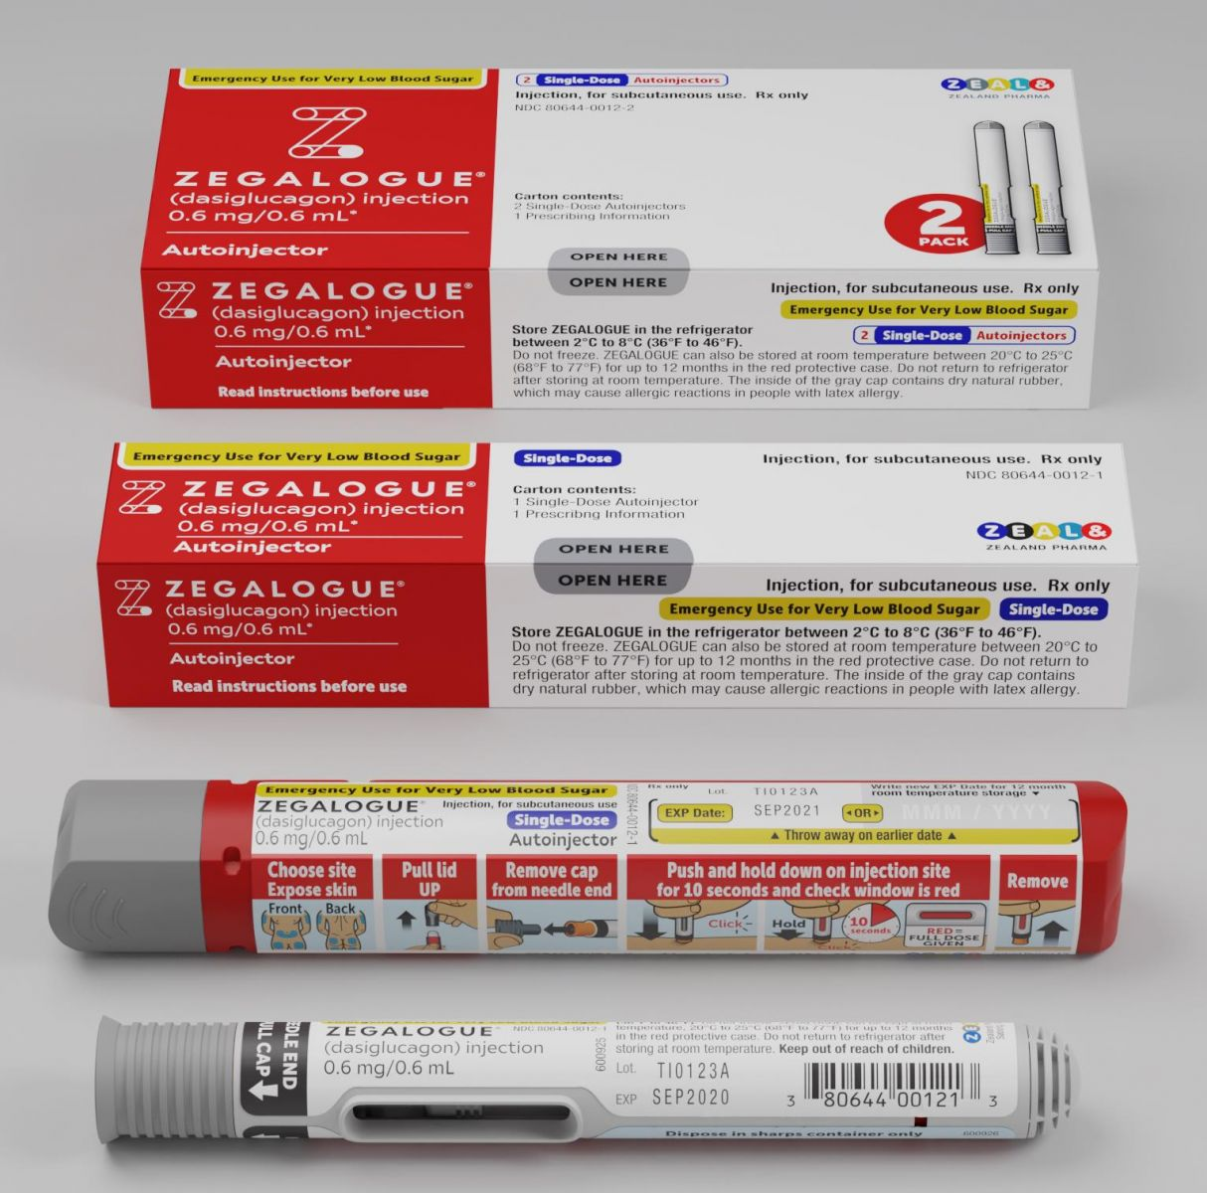
Syringe and vial (e.g., Lilly, Novo Nordisk)
(all ages, dose specific)
Baqsimi nasal powder
(ages 4 and up)
Gvoke Hypopen (auto-injector)
(ages 2 and up)
Gvoke (prefilled syringe)
(ages 2 and up)
Zegalogue (auto-injector)
(ages 6 and up)
Zegalogue (prefilled syringe)
(ages 6 and up)
Ways to Administer Glucagon
Notes:
Glucagon is the fastest means of treating hypoglycemia.
There are currently different ways to administer glucagon: by syringe and vial, by nasal powder, by auto-injector, and by prefilled syringe. The syringe and vial method requires mixing of the solution, followed by injection. The nasal spray, the auto-injectors, and the prefilled syringes are premixed.
The student’s parents/guardian will supply the glucagon kit for school use. They will also provide the orders from the health care provider to give the glucagon and how much glucagon to give.
Glucagon is a pancreatic peptide hormone. It acts to raise the blood level by releasing glucose (sugar) from the liver. It starts to raise the blood sugar within a few minutes, but the duration is short (15-20)… hence the need to call for emergency backup.
Without sugar to the brain severe brain damage or death can occur if not treated quickly.

Slide 24
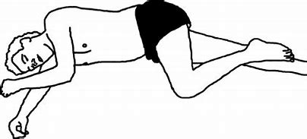
The most common side effects are mild - nausea and vomiting. These reactions may also occur with hypoglycemia.
Keep the student positioned on his or her side to avoid aspiration.
Glucagon Adverse Reactions
Notes:
The side effects include nausea and vomiting. Therefore it is important to keep the student on their side until fully awake to avoid aspiration

Slide 25
Why is it necessary to administer glucagon?
The goal of diabetes care is to keep the blood glucose closer to normal. Despite best efforts hypoglycemia will occur.
Glucagon is the fastest means to raise the blood glucose level.
Notes:
Children may spend significant hours a day at school.
Hypoglycemia must be treated to avoid more complications such as seizures and even death.
Others things to remember is illness and stress have a direct affect on blood sugar control. Blood sugars can go high with illness. Of courses the student should be home when they are sick, but many times students can become ill at school. It is good to know that any stress or illness can and will affect their blood sugars.
There is no cure for diabetes.

Slide 26
Steps for glucagon administration: syringe and vial

Slide 27
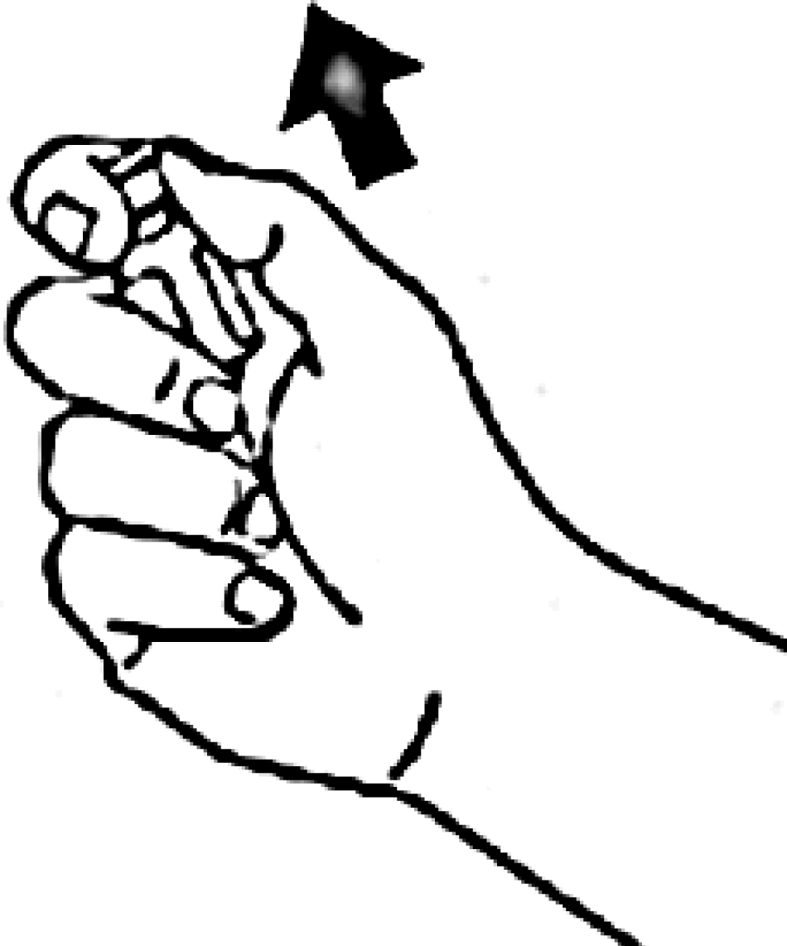
1. Identify someone to call 911
2. Remove flip top seal from vial containing dry powder
3. Remove needle protector from syringe
Syringe and vial

Slide 28
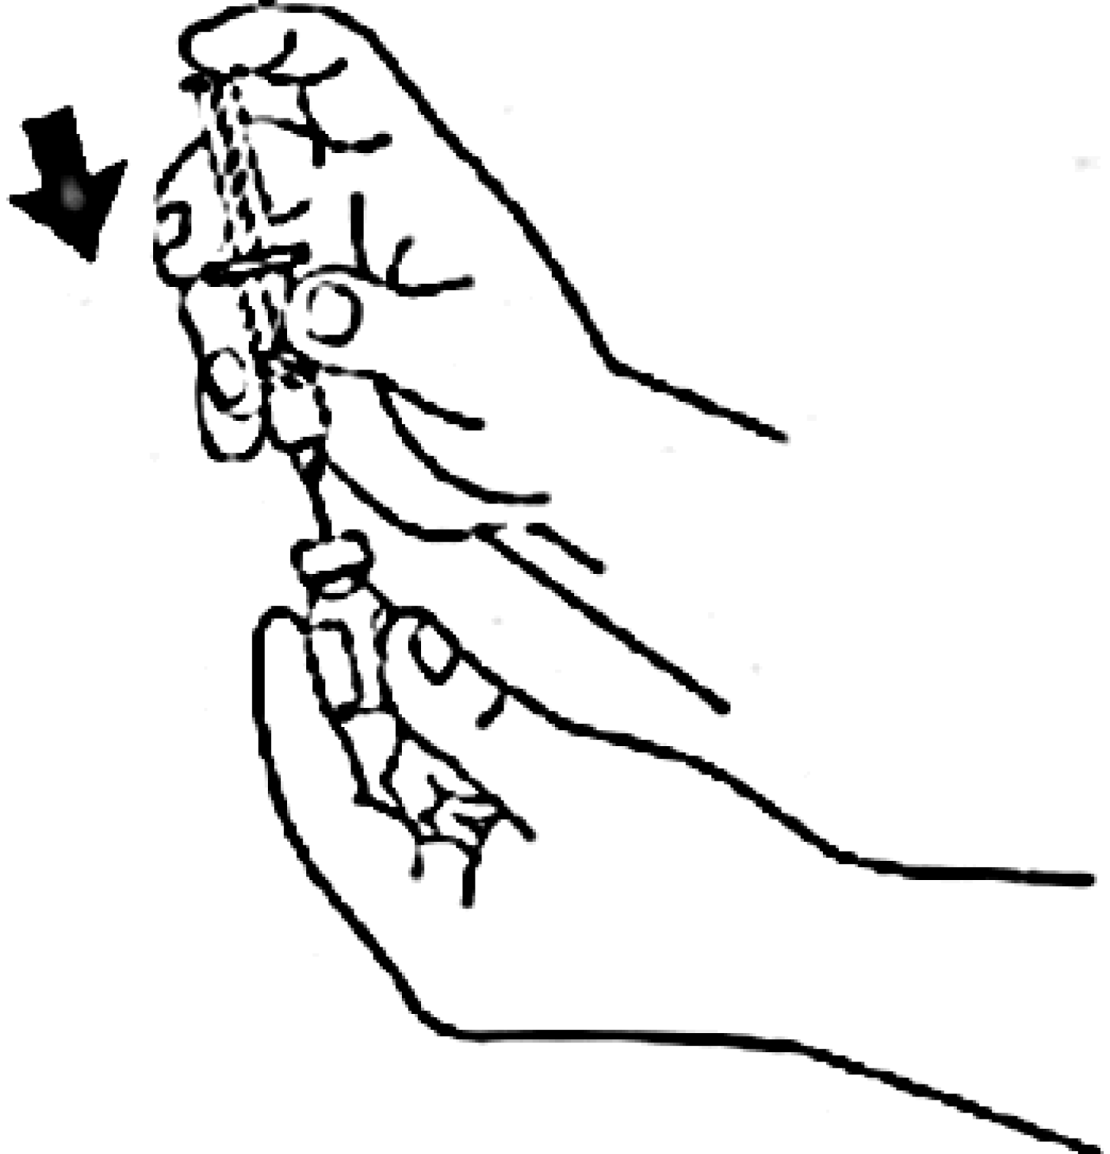
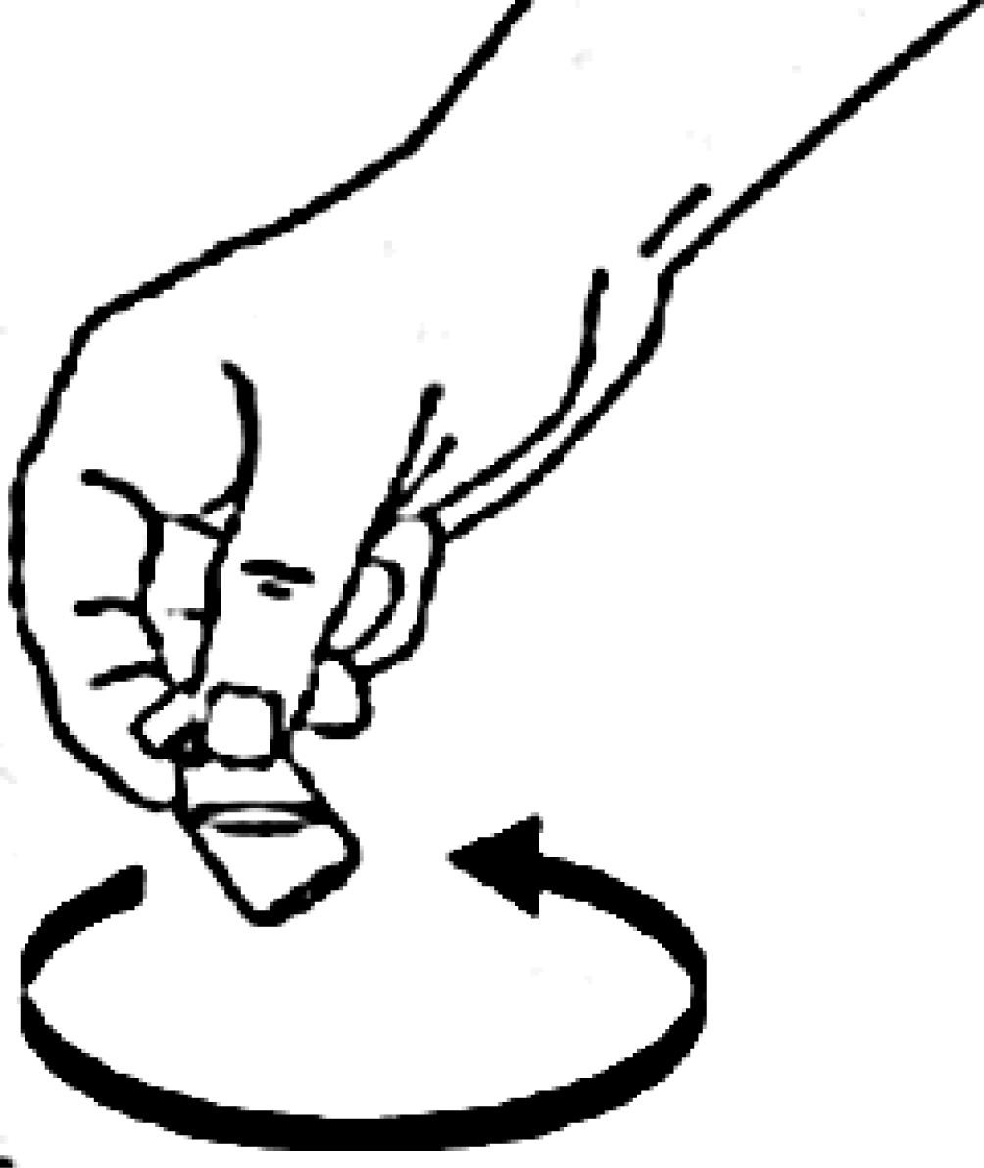
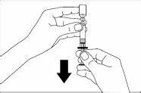
4. Slowly inject all sterile water in syringe into the bottle containing the powder
5. Gently swirl vial until all powder is dissolved and solution is clear (don’t shake vial)
6. Withdraw all glucagon solution from vial
Syringe and vial

Slide 29
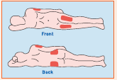
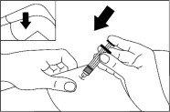
7. Turn student on his/her side
8. Insert needle straight in (90 degree angle)
arm (deltoid) muscle
leg (outer thigh)
Note: Inject through clothing only if necessary
9. Withdraw needle, apply light pressure at injection site
Syringe and vial

Slide 30
10. Place used needle back in kit and close the lid (do not recap)
11. Turn person on their side.
12. Give used kit to EMS personnel
13. Document the date, time, dose on the medication administration form.
Syringe and vial

Slide 31
Steps for glucagon administration: Baqsimi nasal powder https://www.baqsimi.com/how-to-use-baqsimi

Slide 32
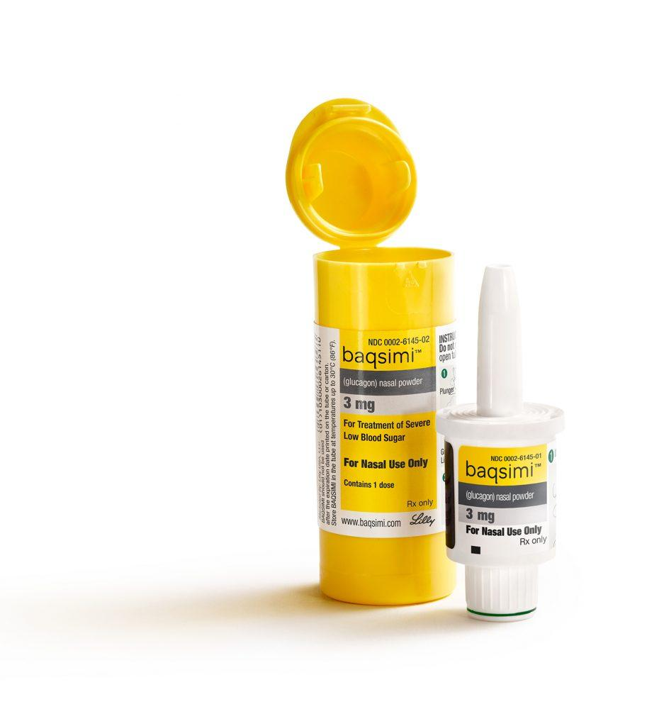
1. Gather medication and put on gloves.
2. Identify someone to call 911.
3. Do not remove shrink wrap or open the tube until you are ready to use it. If shrink wrap is missing or the tube is opened, do not use.
Baqsimi

Slide 33
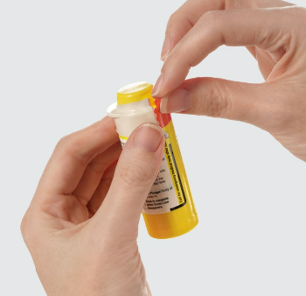
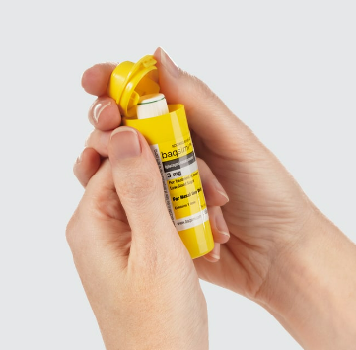
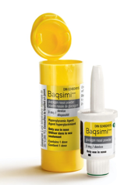
4. Remove shrink wrap by pulling on the red stripe.
5. Open lid and remove the device from the tube. Caution: do not press the plunger until ready to give the dose.
Baqsimi

Slide 34
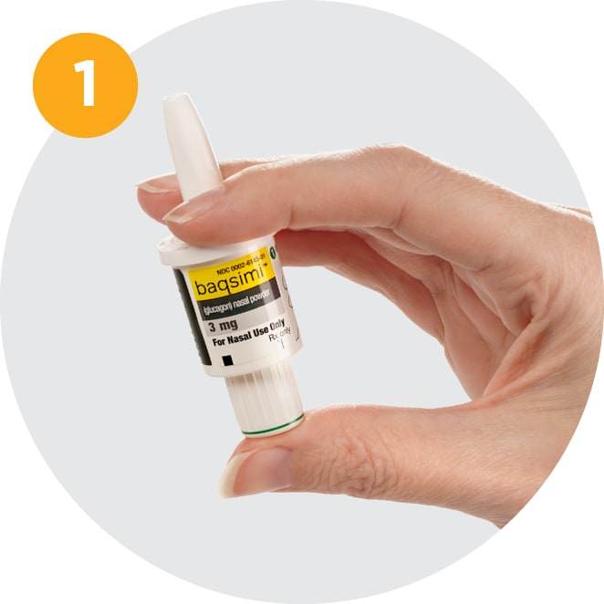
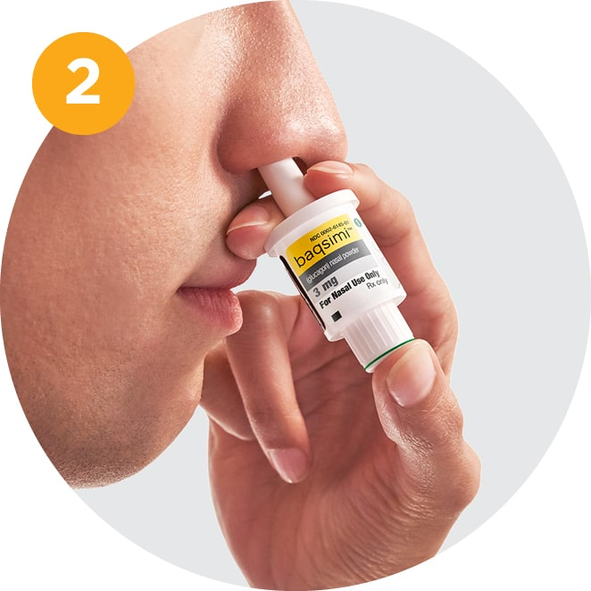
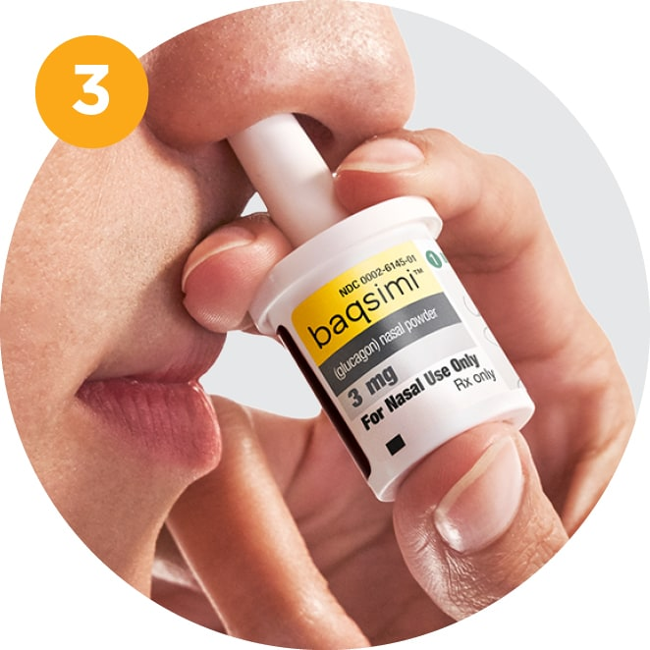
6. Hold device between fingers and thumb. Do not push plunger yet.
7. Insert tip gently in one nostril until fingers touch the outside of the nose.
8. Push plunger firmly all the way in. Dose is complete when the green line disappears.
Baqsimi
Giving the Dose

Slide 35
9. Turn the person on their side.
10. Give used device to EMS personnel.
11. Document the date, time, dose on the medication administration form.
Baqsimi

Slide 36
Steps for glucagon administration: Gvoke hypopen
(auto-injector) https://gvokeglucagon.com/#fullisi

Slide 37
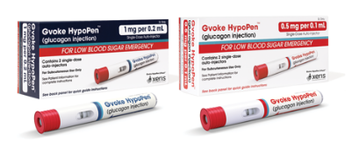
Identify someone to call 911.
Gather Gvoke and put on gloves.
Open the pouch and make sure the medication looks clear and almost colorless. If cloudy or has visible particles, do not use.
Gvoke Hypopen (auto-injector)

Slide 38
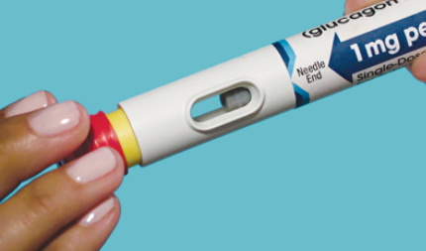
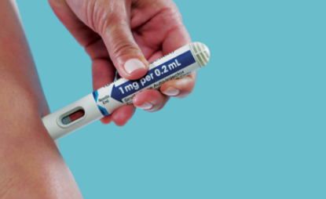
4. If alcohol is available, clean the injection site.
5. Pull red cap off.
6. Push yellow end down on skin and hold for 5 seconds.
Gvoke Hypopen (auto-injector)

Slide 39
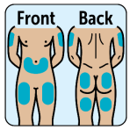
7. Administer to upper arm, stomach, or thigh.
8. Turn person on their side.
9. Give used device to EMS personnel.
10. Document the date, time, dose on the medication administration form.
Gvoke Hypopen (auto-injector)

Slide 40
Steps for glucagon administration: Zegalogue auto-injector https://www.zegalogue.com/zegalogue-autoinjector-instruction-for-use.pdf

Slide 41
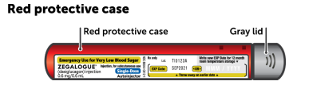
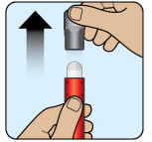
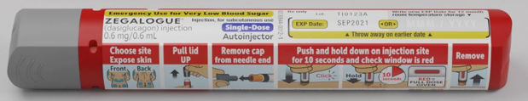
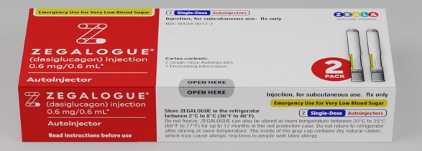
Identify someone to call 911.
Gather Zegalogue auto-injector and put on gloves.
Hold the red protective case upright and remove gray lid. Carefully remove Zegalogue device from the red protective case without dropping it.
If alcohol is available, clean the injection site.
Zegalogue Auto-injector

Slide 42
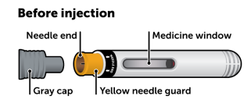
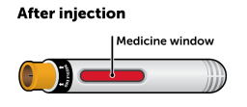
5. Pull gray cap straight off.
6. Push yellow end straight down on skin until the yellow needle guard is fully pressed down. You may hear the first click.
Hold in place and slowly count to 10. During this time the medication window will turn red and you may hear a second click.
Check that the medicine window is red, which means that the full dose has been given.
Zegalogue Auto-injector

Slide 43
7. Administer to upper arm, stomach, or thigh.
8. Turn person on their side.
9. Give used device to EMS personnel.
10. Document the date, time, dose on the medication administration form.
Zegalogue Auto-injector

Slide 44
Steps for glucagon administration: Gvoke prefilled syringe https://gvokeglucagon.com/#fullisi

Slide 45
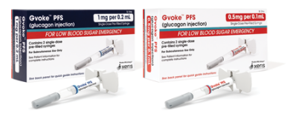
Identify someone to call 911.
Gather Gvoke prefilled syringe and put on gloves.
Hold the red protective case upright and remove gray lid. Carefully remove Gvoke syringe from the red protective case without dropping it.
If alcohol is available, clean
the injection site.
Gvoke prefilled syringe

Slide 46




5. Pull the gray needle cover straight off. Be careful not to bend the needle.
6. Pinch the skin and insert the needle at a 90 degree angle.
Return syringe to red protective case and put gray lid back on. DO NOT recap the needle.
Gvoke prefilled syringe

Slide 47
7. Administer to upper arm, stomach, or thigh.
8. Turn person on their side.
9. Give used device to EMS personnel.
10. Document the date, time, dose on the medication administration form.
Gvoke prefilled syringe

Slide 48
Steps for glucagon administration: Zegalogue prefilled syringe https://www.zegalogue.com/zegalogue-PFS-instruction-for-use.pdf

Slide 49



Gather Zegalogue prefilled syringe and put on gloves.
Identify someone to call 911.
Hold the red protective case upright and remove gray lid. Carefully remove Zegalogue syringe from the red protective case without dropping it.
4. If alcohol is available, clean the
injection site.
Zegalogue prefilled syringe

Slide 50
5. Pull the gray needle cover straight off. Be careful not to bend the needle.
6. Gently pinch the skin and insert the entire needle into the skin at a 45 degree angle.
After inserting the needle, release the pinched skin and slowly press the plunger rod all the way down until the syringe is empty and the plunger rod stops.
Return syringe to red protective case and put gray lid back on.
DO NOT recap the needle.
Zegalogue prefilled syringe

Slide 51
7. Administer to upper arm, stomach, or thigh.
8. Turn person on their side.
9. Give used device to EMS personnel.
10. Document the date, time, dose on the medication administration form.
Zegalogue prefilled syringe

Slide 52
Let’s Practice!

